Slide 2
World Space Week Exhibit
Presented by: Pupils
The Twelfth Elementary School
Al Hasa/ Eastern Province / Kingdome of Saudi Arabia
Teachers:
Mrs: Layla Alhasan Mrs. Fatimah Bu Azran
School Prnciple: Mrs. Buthaina Al Essa

Slide 4
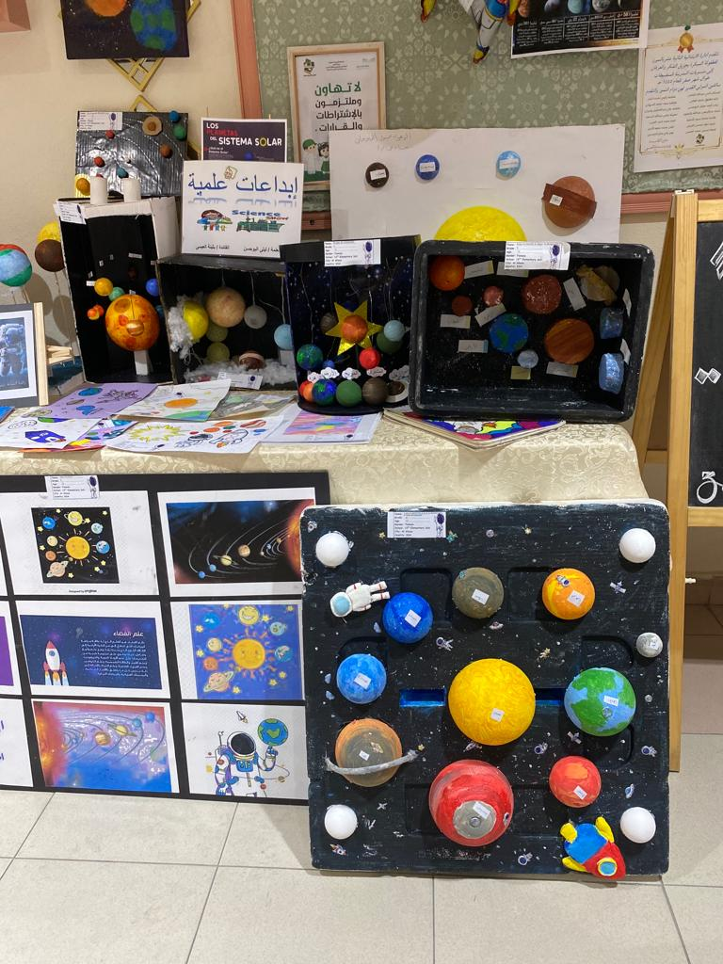
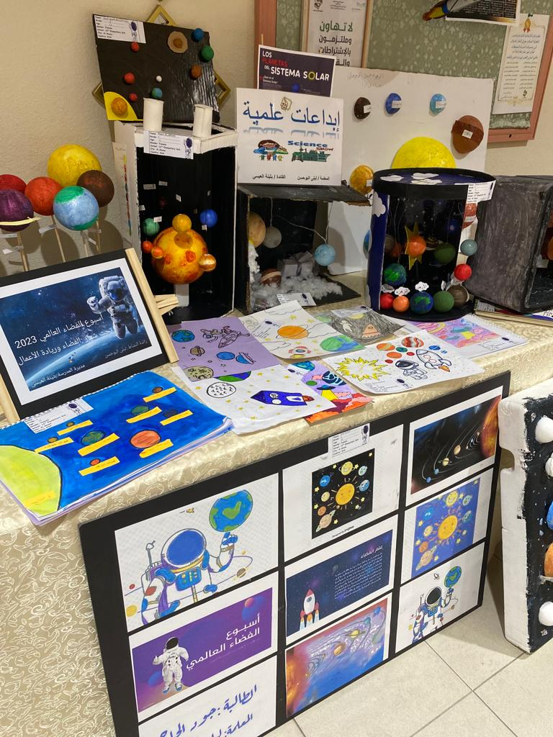
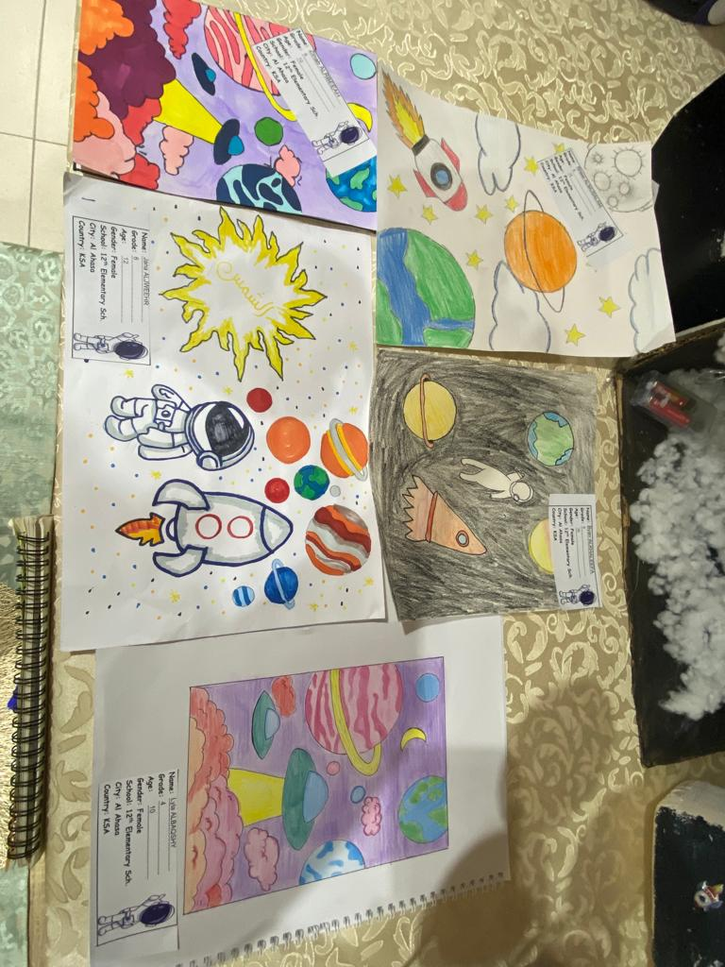

Slide 5
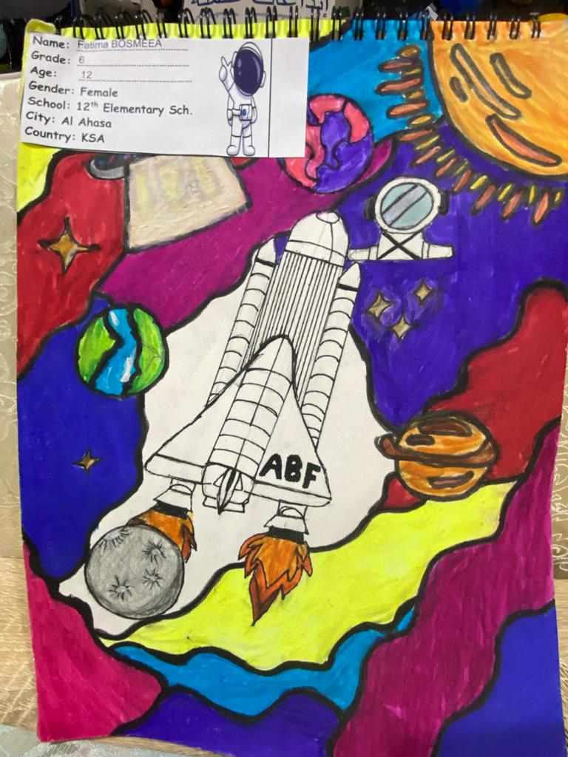
Name: Fatimah Bosmeea
Grade: Sixth Grade
Age: 12 Years old
Gender: Female
School: 12th Elementary School
City: Al Hasa
Country: KSA

Slide 6
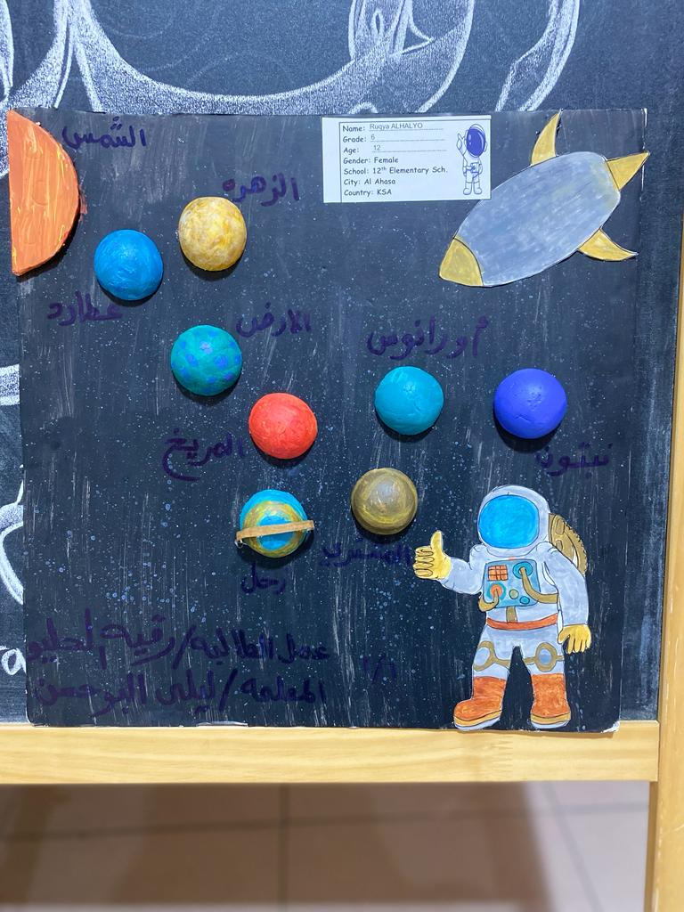
Name: Rugya Alhalyo
Grade: Sixth Grade
Age: 12 Years old
Gender: Female
School: 12th Elementary School
City: Al Hasa
Country: KSA

Slide 7
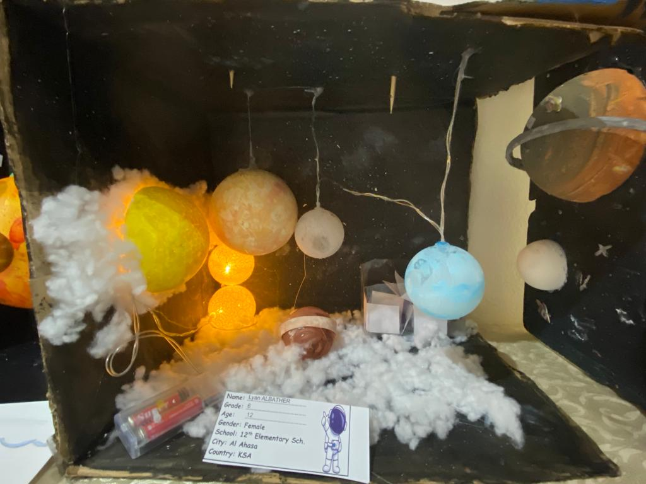
Name: Layan Al Bathar
Grade: Sixth Grade
Age: 12 Years old
Gender: Female
School: 12th Elementary School
City: Al Hasa
Country: KSA

Slide 8
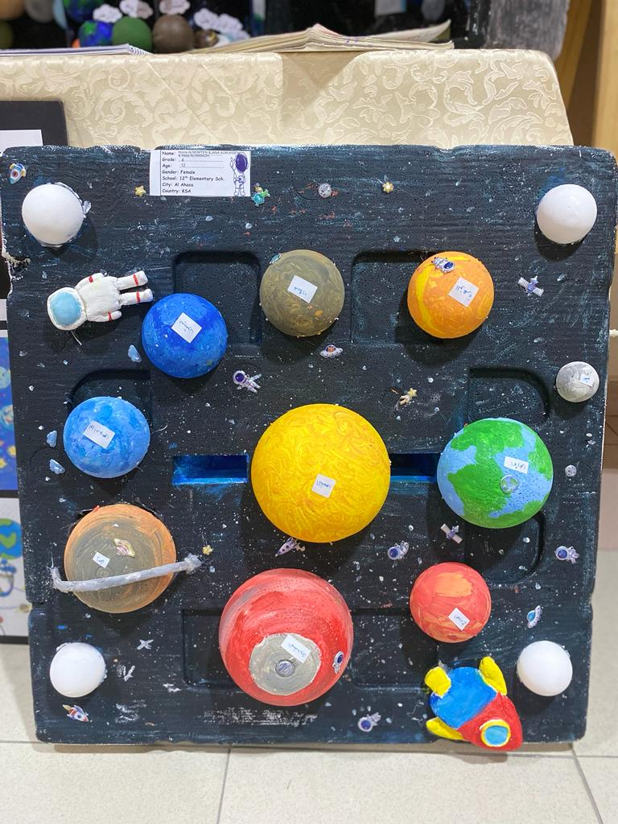
Name: Noura Al Momaten & Jenan Al Muhsen
Grade: Sixth Grade
Age: 12 Years old
Gender: Female
School: 12th Elementary School
City: Al Hasa
Country: KSA

Slide 9
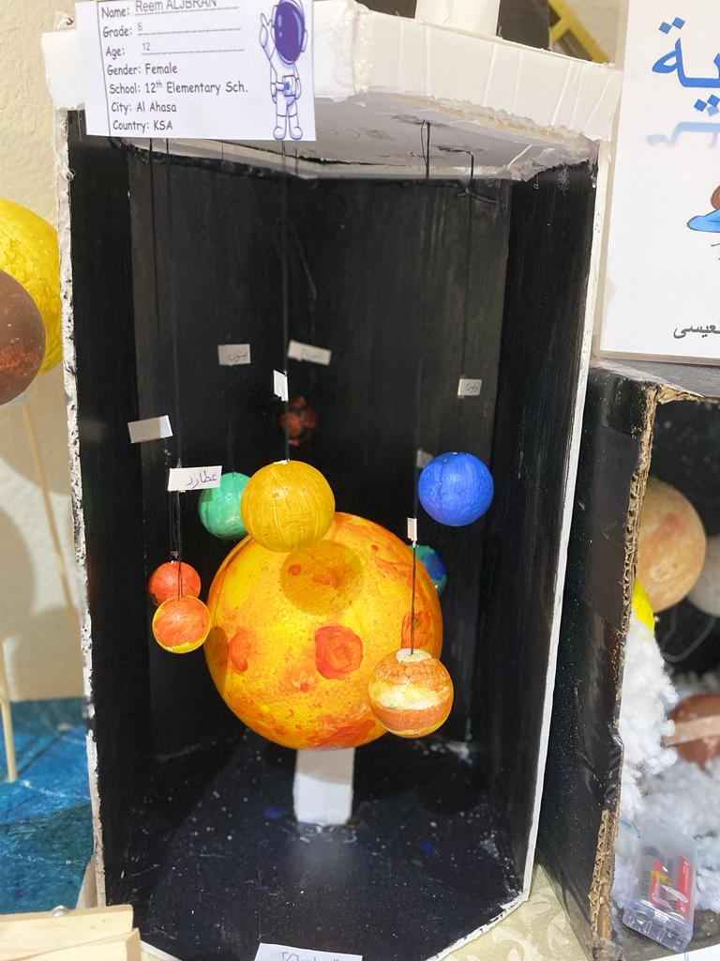
Name: Jena Al Jwaiher
Grade: Sixth Grade
Age: 12 Years old
Gender: Female
School: 12th Elementary School
City: Al Hasa
Country: KSA

Slide 10
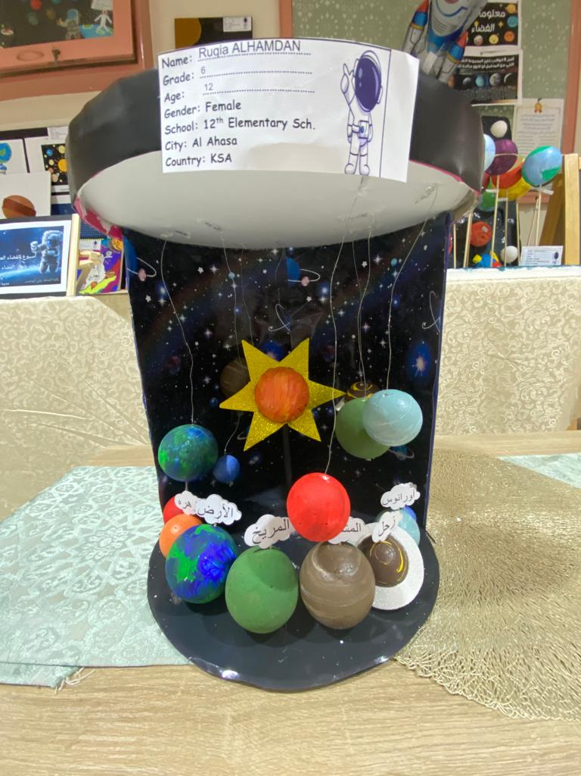
Name: Azhar Al Jaman
Grade: Sixth Grade
Age: 12 Years old
Gender: Female
School: 12th Elementary School
City: Al Hasa
Country: KSA

Slide 11
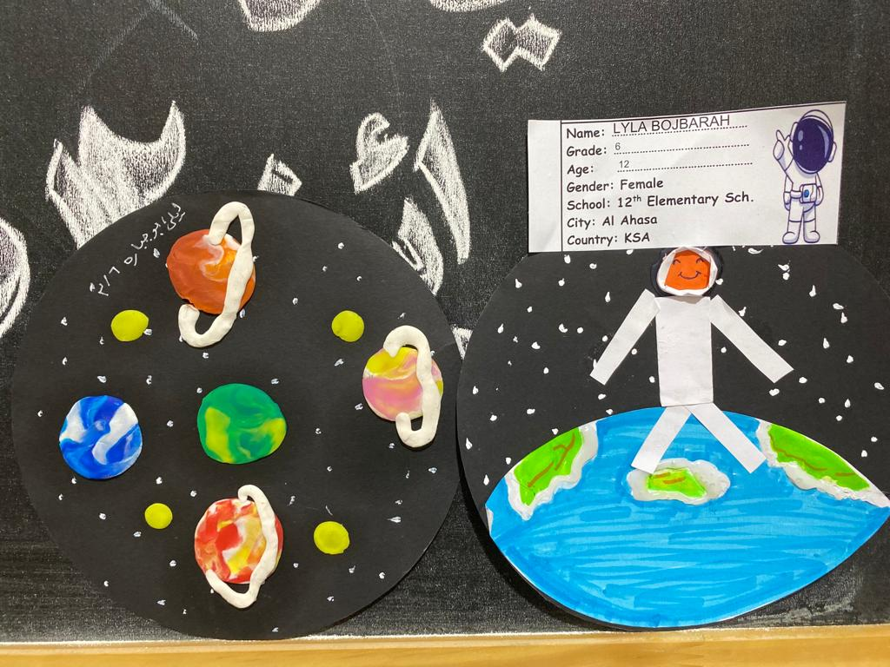
Name: Layla Bojbarah.
Grade: Sixth Grade
Age: 12 Years old
Gender: Female
School: 12th Elementary School
City: Al Hasa
Country: KSA

Slide 12
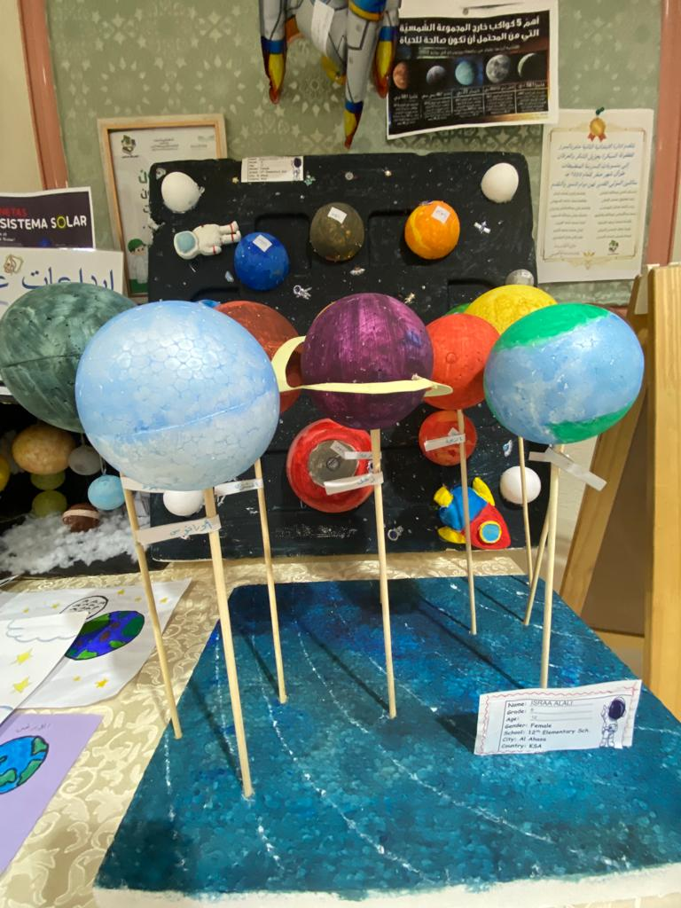
Name: Israa Al Ali
Grade: Sixth Grade
Age: 12 Years old
Gender: Female
School: 12th Elementary School
City: Al Hasa
Country: KSA

Slide 13
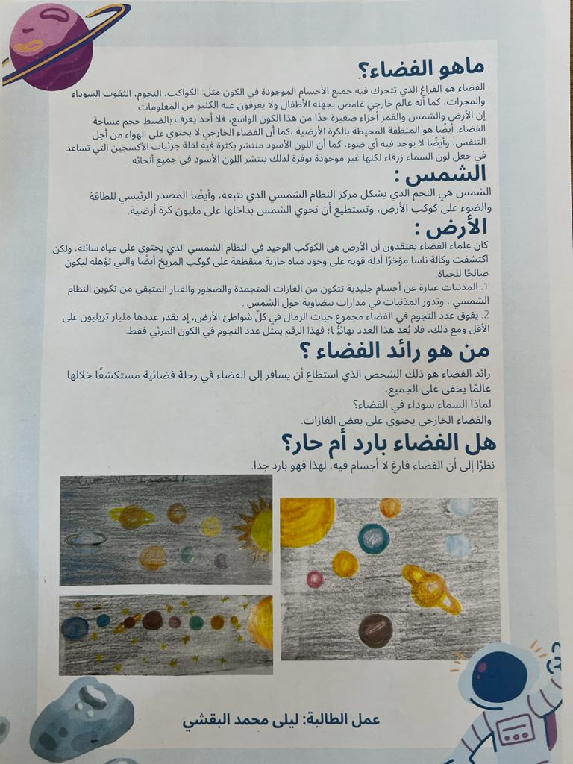
Name: Layla Al Baghshi.
Grade: Fifth Grade
Age: 10 Years old
Gender: Female
School: 12th Elementary School
City: Al Hasa
Country: KSA

Slide 14
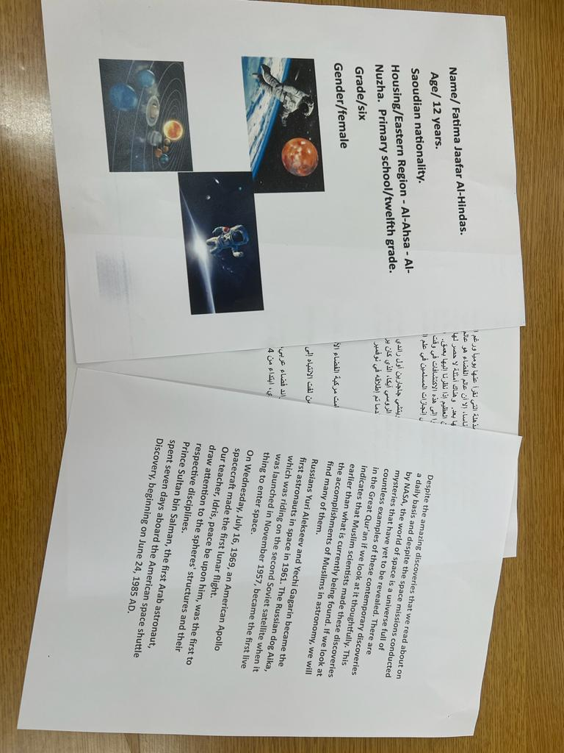
Name: Fatimah Al Hindas
Grade: Sixth Grade
Age: 12 Years old
Gender: Female
School: 12th Elementary School
City: Al Hasa
Country: KSA

Slide 15
Images and Background:
https://www.worldspaceweek.org/about
https://www.pinterest.com/
Sources:

